Slide 1
임상연구결과 발표 clinical implication of intraoperative cortico-cortical evoked potential monitoring
2021. 02. 15
F. 유일한

Slide 2
Contents
1. clinical implication of intraoperative cortico-cortical evoked potential monitoring

Slide 10
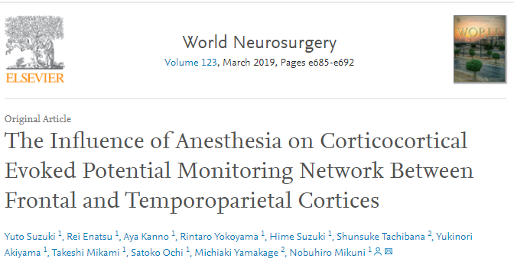
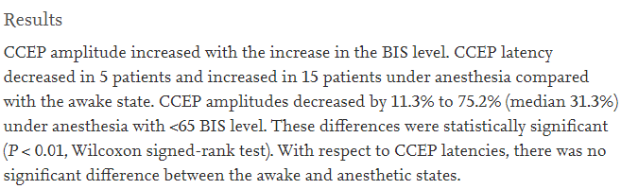

Slide 19
Direction of study
Anti-inflammatory cytokine: TGF-β, IL-4, IL-10, Th1 transcription factor Tbx21
Pro-inflammatory cytokine: IFN-γ.
Correlation between CD25, FoxP3 and TGF-β, IL-4, IL-10, Th1 transcription factor Tbx21, IFN-γ
Microglia and astrocyte promotion in early stage (neuroprotective activity: anti-inflammatory and protect motoneurons), suppression in late stage (neurotoxic activity: accelerate motoneuron injury by misfolded proteins, pro-inflammatory glial cascade). Which molecules make this difference?, identification of glial-motoneuron signalling
When study about microglia and astrocytes, PET-imaging for detecting activated state of them, correlate with disease state and their activity and conclude to their role in pathophysiology and progression. Need for another ligand that can differentiate anti-inflammatory from proinflammatory microglia and astrocytes, inflammatory phenotypes of peripheral macrophages and T lymphocytes.

